Slide 1
File and Share Access
CS240W

Slide 2
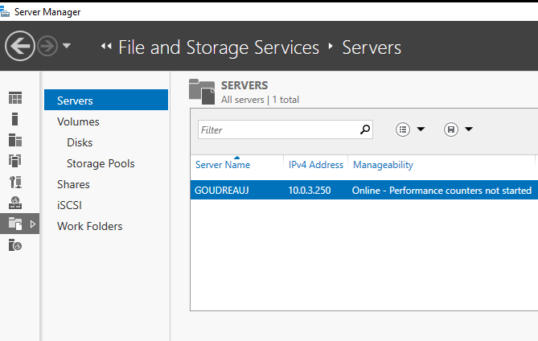
File and Storage Services
File and Storage Services is a core role in Windows Server that allows organizations to manage file sharing, data storage, and access control efficiently. This service is critical for centralized data management, ensuring secure and high-performance file sharing across networked users and applications.
Notes:
iSCSI (Internet Small Computer System Interface) By
It is a protocol that enables the connection of storage devices over a network using TCP/IP.

Slide 3
NTFS Permissions
Read: Users can view/read files and file properties.
Write: Users can write to a file.
List Folder Contents: See lists of file and file properties.
Read & Execute: Users can run executable files, including scripts.
Modify: Users can view and modify files and file properties, including deleting and adding files to a directory or file properties to a file.
Full Control: Users can modify, add, move, and delete files, as well as their associated properties and directories. Users can change permissions for all files and subdirectories.

Slide 4
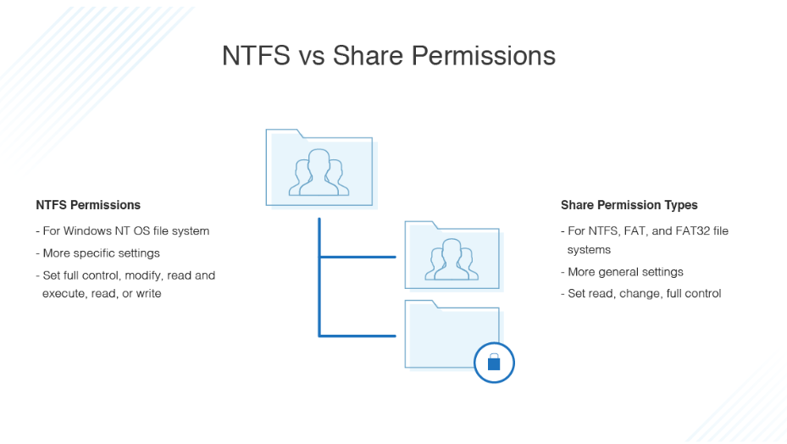
NTFS vs Share
https://www.dnsstuff.com/ntfs-vs-share-permissions
Notes:
When we share a folder in windows server we use 2 different types of permissions
NTFS and Share Permissions
Applied to files & folders
Advanced
Share Permissions
Applied to shared folders
basic
User connects to Share

Slide 5
Effective Permissions
When calculating effective permissions, the computer takes into consideration all groups the user is a member of. The most permissive group/user permission is applied as the effective permission.
You cannot take away permissions by adding a user to a group with no permissions.

Slide 6
Shares
Simple File Sharing
  Folder names are used as share names
Advanced File Sharing
  Allows custom names
  Add $ to end to hide share
Universal Naming Convention (UNC): \\SERVER\SHARE
Permissions: Read, Change, and Full Control

Slide 7
Sharing files
SMB (Server Message Block) Protocol
  Windows
    CIFS (Common Internet Fiel System)
      A version of SMB that is considered out of date.
NFS (Network File System) Protocol
  Used in Linux/Unix
Note: Both can be setup to work in both environments.

Slide 8


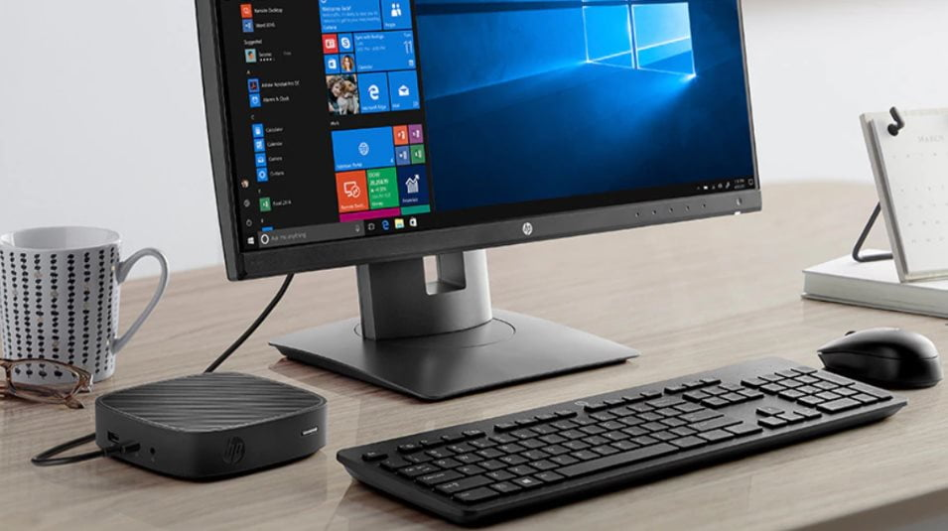
VirtualBox
Host*
Client
Server

Slide 9
Server Message Block (SMB) Protocol
Originally designed at IBM for use in DOS operating systems.
Microsoft started working with it in 1990 and has incorporated it in Windows since 3.1.1
Originally designed to allow a Microsoft client to talk to a Microsoft Server.
Samba is the standard Windows interoperability suite of programs for Linux and Unix.

Slide 10
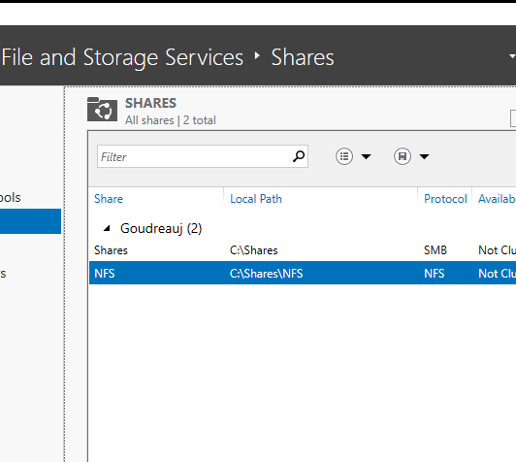
Shares in server manager
It will tell you the protocol and what shares you have on your system.

Slide 11
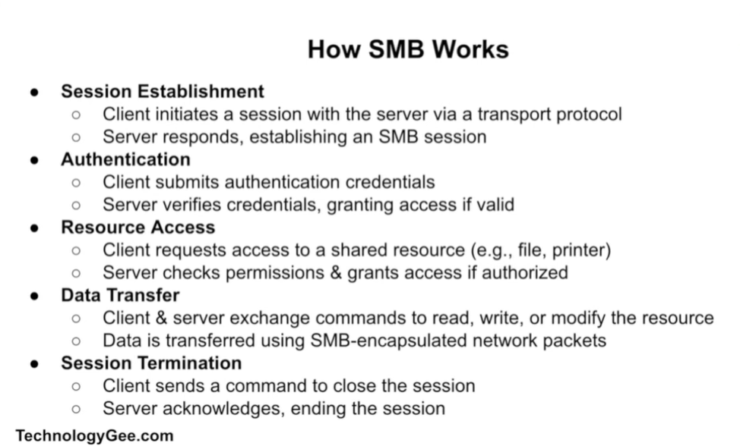
How SMB Works

Slide 12
Network File System Protocol
NFS Allows one to mount remote directories into the local directory structure
Developed by Sun Microsystems (now Oracle) in 1984.
  Current version (April 2003): NFSv4 - Uses TCP Protocol (older versions also allowed UDP)
Built in Open Network Computing Remote Procedure Call (ONC RPC).
Open Standard: RFCs 1094, 1813, 3010, 3530, 5661
  A Request for Comments (RFC) is a memorandum published by the Internet Engineering Task Force (IETF) describing methods, behaviors, research, or innovations applicable to the working of the Internet, along with Internet-connected systems.
https://www.rfc-editor.org/rfc/rfc1094.html
Notes:
TCP is a connection-oriented protocol, whereas UDP is a connectionless protocol. A key difference between TCP and UDP is speed, as TCP is comparatively slower than UDP. Overall, UDP is a much faster, simpler, and efficient protocol, however, retransmission of lost data packets is only possible with TCP.

Slide 13
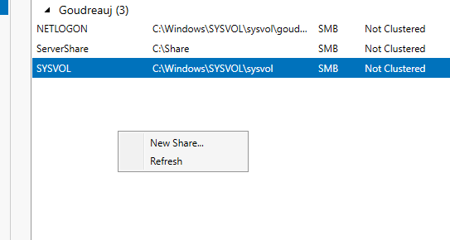
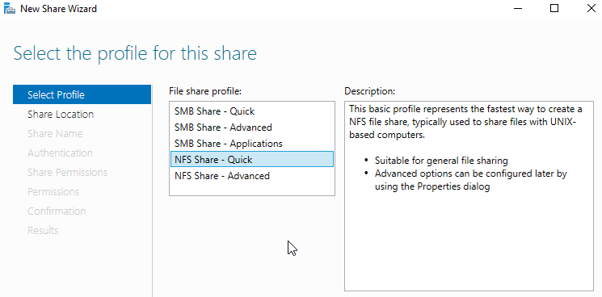
Creating a new share

Slide 14
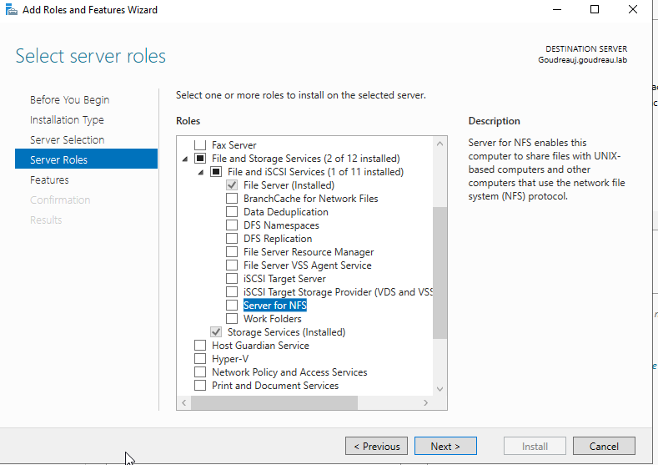
To add NFS in Windows server 2022

Slide 15
SMB vs NFS
NFS better for Unix/Linux, while SMB better for Windows.
NFS requires extra tools to support Apple, but SMB does not.
NFS runs in Unix/Linux and Windows; SMB needs Samba to do so.
NFS file locking is mandatory or advisory, but SMB locking is mandatory.
NFS has no fast file find; SMB has fast find.
NFS no server and printer browsing, while SMB has server and printer browsing.
NFS slower reads and writes; SMB faster.
NFS better with small files, while SMB fine with small files but better with large files.
https://www.computerweekly.com/feature/NFS-vs-SMB-vs-CIFS-File-storage-protocols-defined
Notes:
https://ferhatakgun.com/network-share-performance-differences-between-nfs-smb/

Slide 16
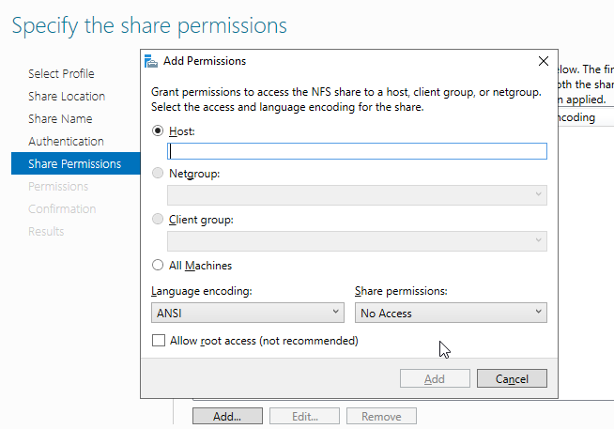
Host
Normally you'd want to limit who has access to the files. For our purposes you can set it to all.
Note: This host I believe refers to a machine on your network so like 10.0.2.15

Slide 17
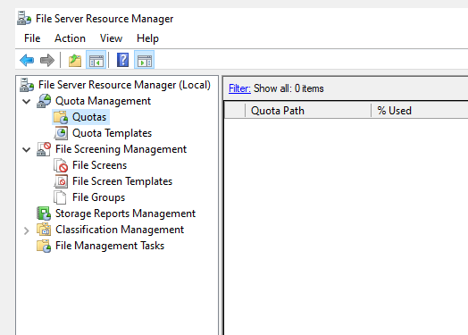
File Server Resource Manager
Needs to be added in as a Role.
Allows you to create Quotas and limit the type of files allowed on a system among other things.

